Slide 1

U.S. Housing
Constraints
Presented by: David Burke, Casey Wright, Camden Beck and Hawa Abdo

Slide 2
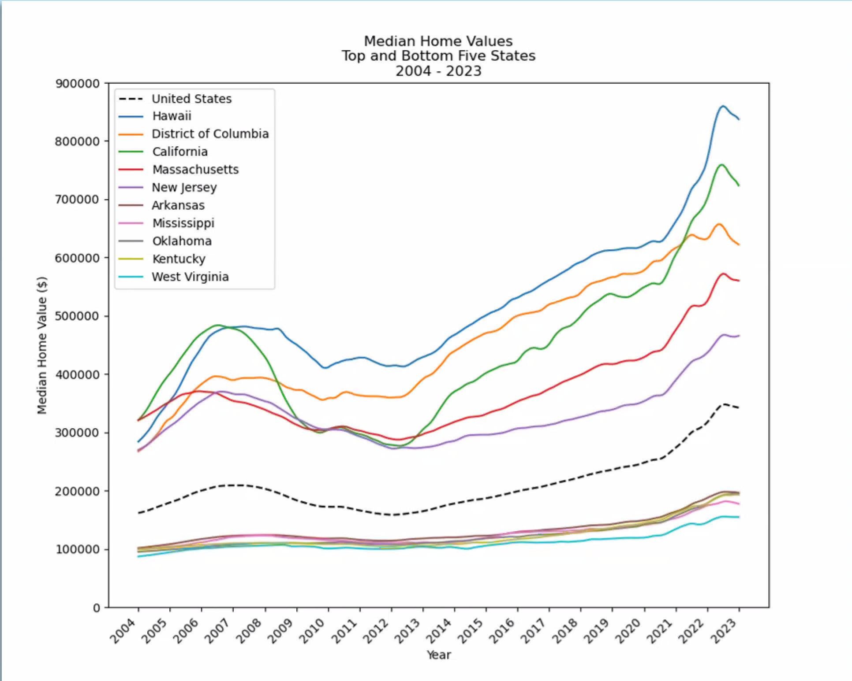
Median Home Value Top and Bottom 5 States
Range between highest and lowest has increased by 191% ($448,730) since 2004.
U.S. median increased by 112% ($180,759).
Bottom states are more clustered and have little change.
Top states have much greater separation and volatility, with large peaks and valleys.

Slide 3
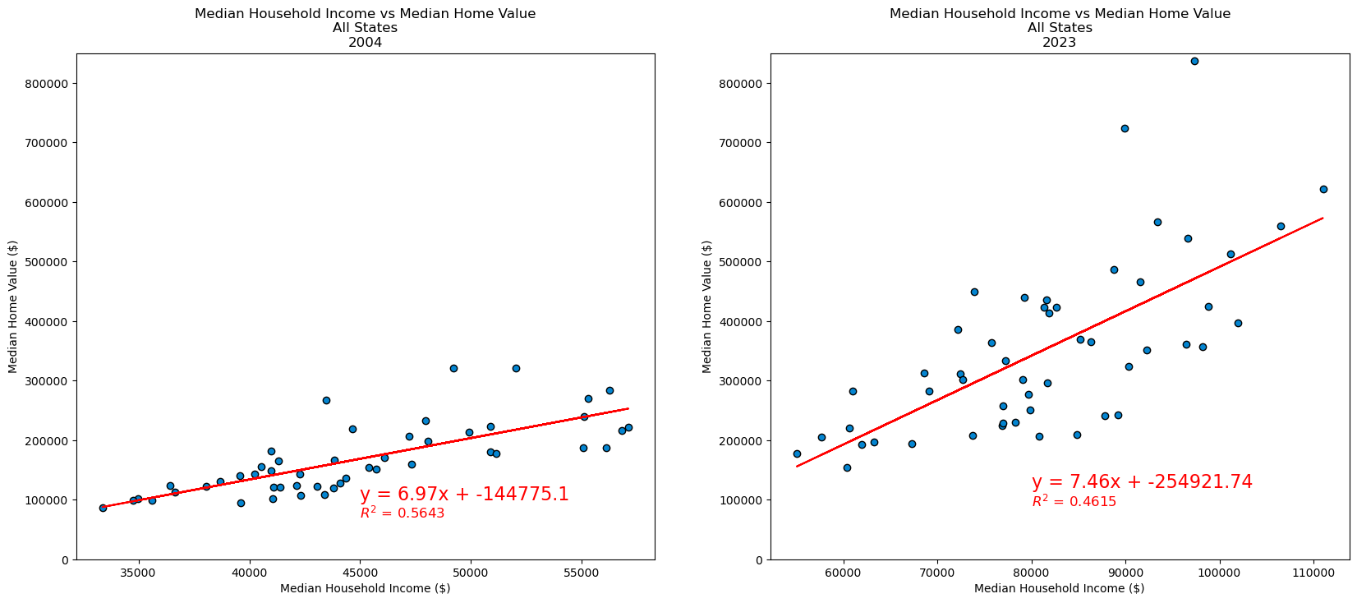
Linear Regression Models Home Value vs Income
Moderate correlation between home value and income
R² decreased from 0.56 in 2004 to 0.46 in 2023, indicating income has become less reliable as a predictor of home value

Slide 4
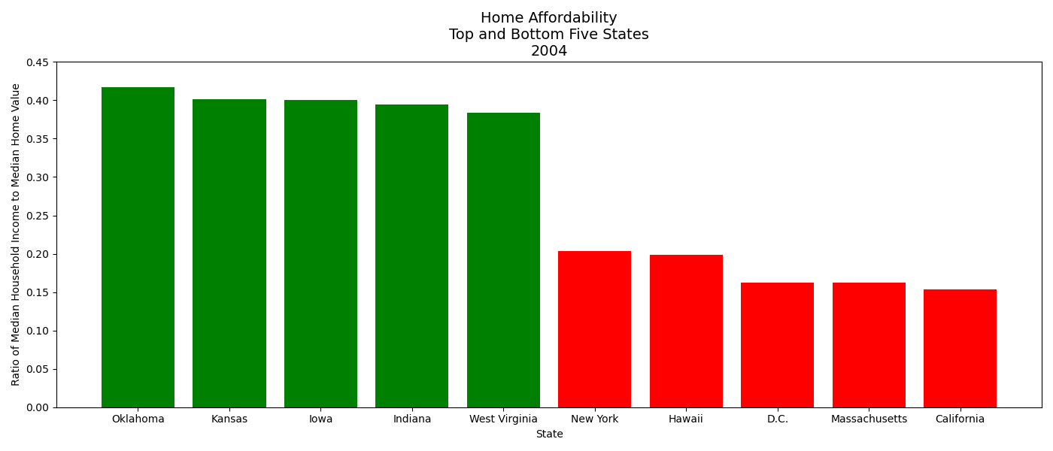
Home Affordability 2004
Median Household Income
Affordability =
Median Home Value
Top 5 states are predominantly rural. Bottom 5 (except Hawaii) have large urban areas.
Oklahoma is the most affordable, California the least.

Slide 5
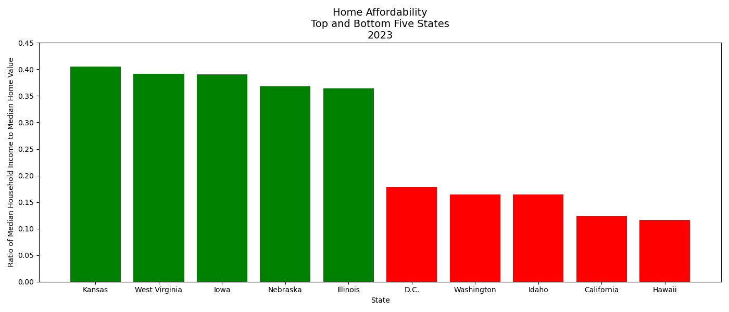
Home Affordability 2023
Overall, affordability has decreased compared to 2004
Kansas is most affordable. Oklahoma no longer in the Top 5.
Illinois is 5th most affordable, despite having the 3rd largest U.S. city (Chicago)
Hawaii is least affordable, overtaking California
But California is less affordable than in 2004
Idaho is 3rd least affordable

Slide 6
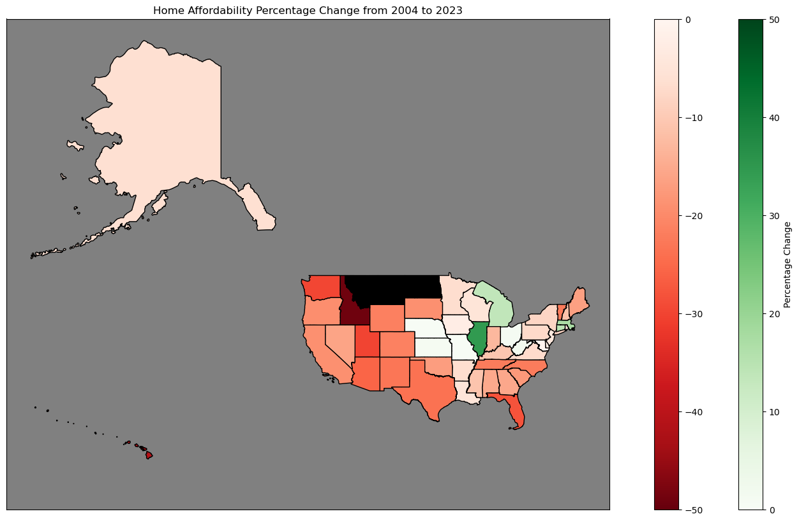
Home Affordability Percentage Change 2004-2023
Most states have decreased in affordability (red). Few have increased (green).
Largest increase: Illinois (+34%)
Largest decrease: Idaho (-50%)
Note: No Home Value data for Montana and North Dakota in 2004

Slide 7
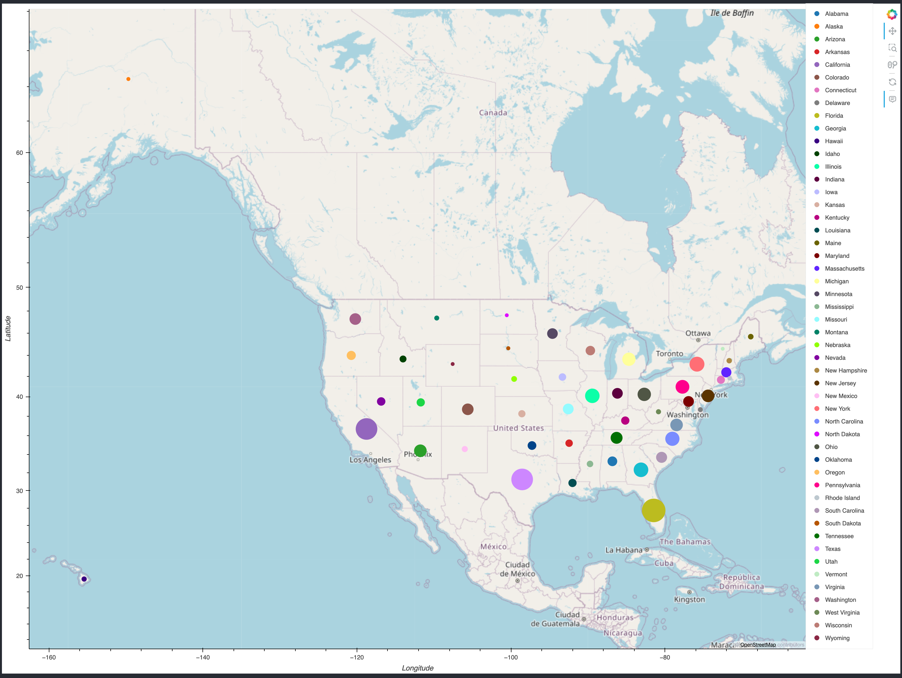
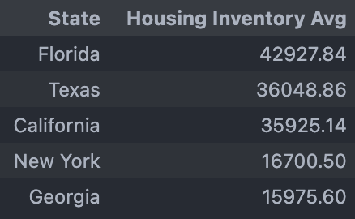
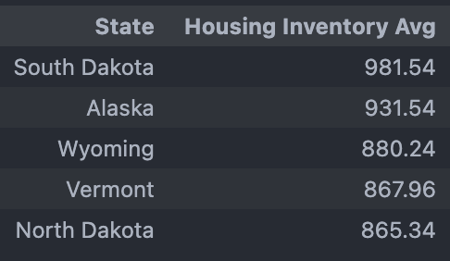
New Home Listings Averages (2004-2024)
Top 5 States
Bottom 5 States

Slide 8
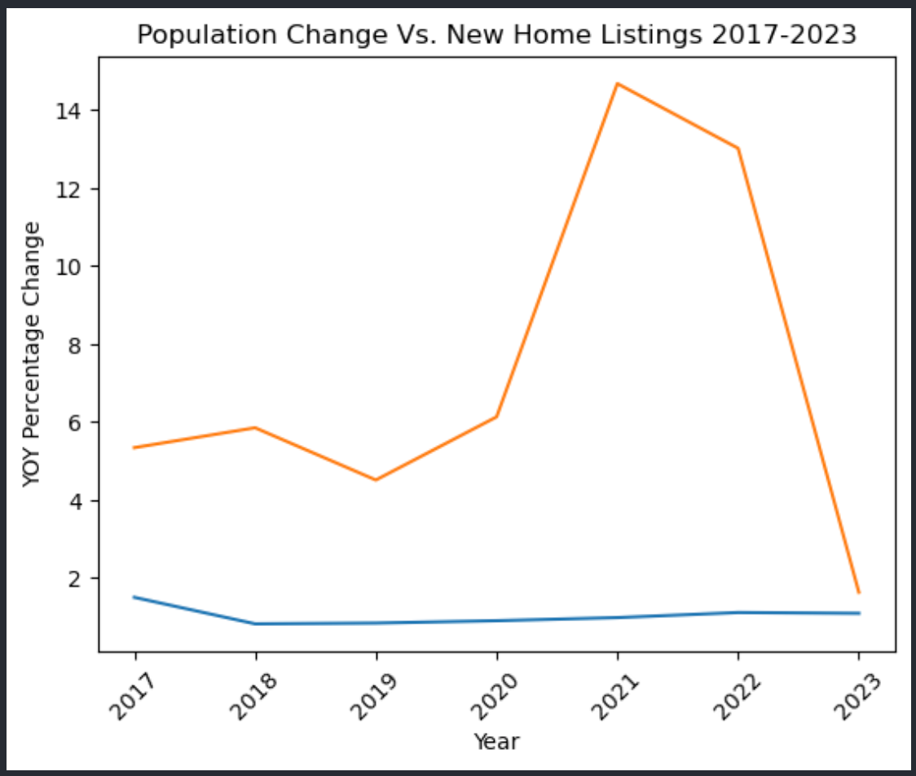
U.S. Population vs New Home Listings (2017 – 2023)
The compounded annual growth rate for the U.S. Population was 7.54% between 2017 and 2023
The compounded annual growth rate for New Home Listings Between 2017 and 2023 was 0.96%.
The U.S. Population growth rate out paced new home listings by 6.58% (Difference Between the two growth rates)

Slide 9
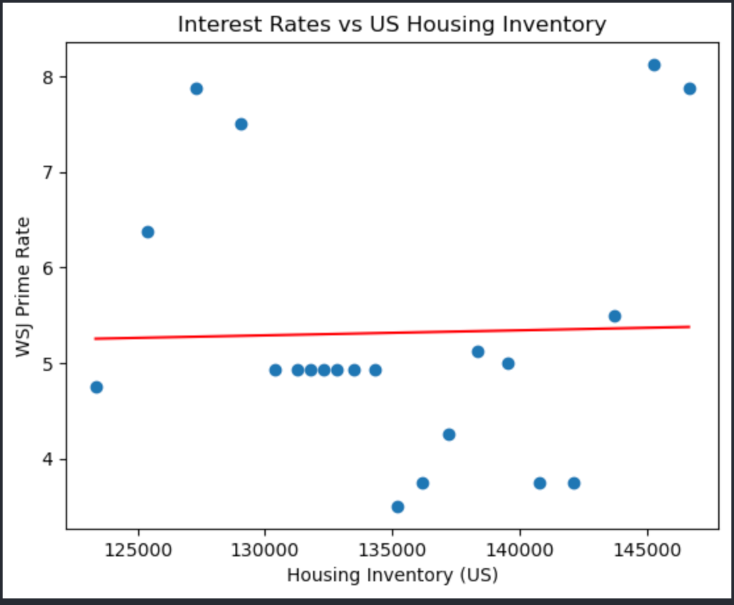
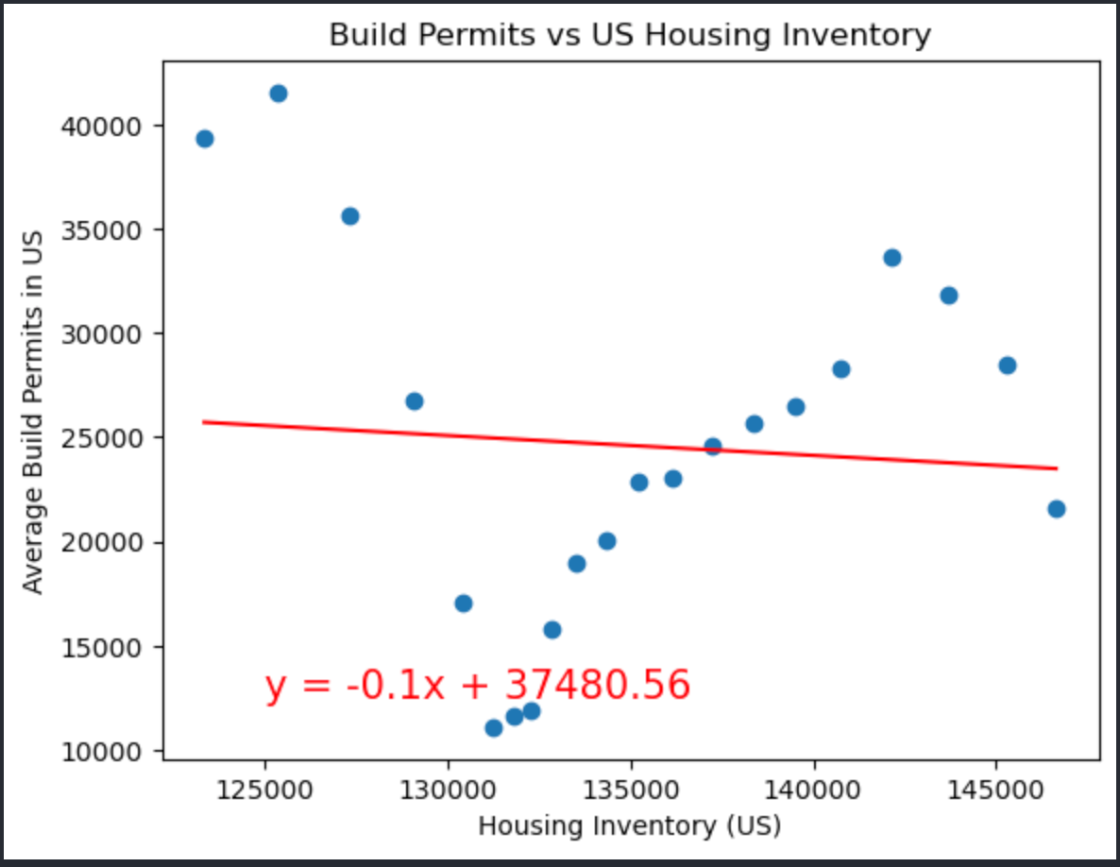
U.S. Housing Inventory (By New Home Listings)
R-value: 0.0005703265458220814
R-value: 0.004945153088260975

Slide 10
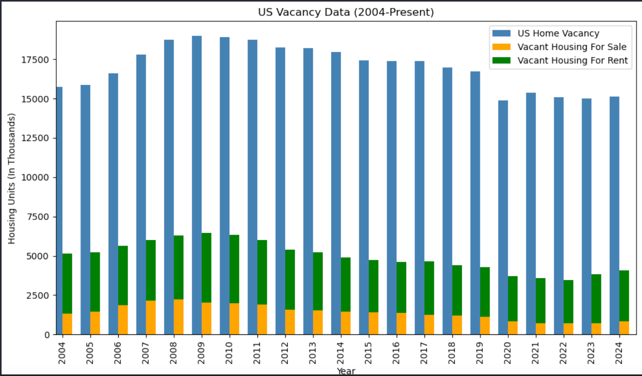
U.S. Home Vacancies
Many of the homes that are vacant in the U.S. are not available for sale or rent
Home vacancies (not available for sale or rent) could be attributed to the following:
Unhabitable Homes
In need of renovation.
Currently being renovated.
Holding for speculative purposes
Housing currently in development
Second home/vacation home
Reducing the number of home vacancies that are not up for sale or rent could help reduce or alleviate some of the housing constraints in the U.S.

Slide 11
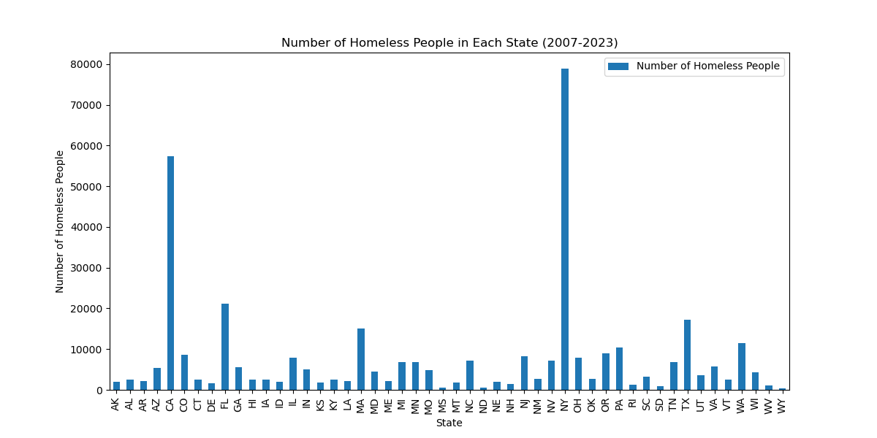
Homelessness Total Number of Homeless Individuals in Each State Aggregated from 2007-2023
States with the highest homeless count:
New York: 78,920
California: 57,468
Florida: 21,121
State with the lowest homeless count:
Wyoming: 405
North Dakota: 548
Mississippi: 626
The differential between the homeless count in New York Vs. Wyoming: 78,515

Slide 12
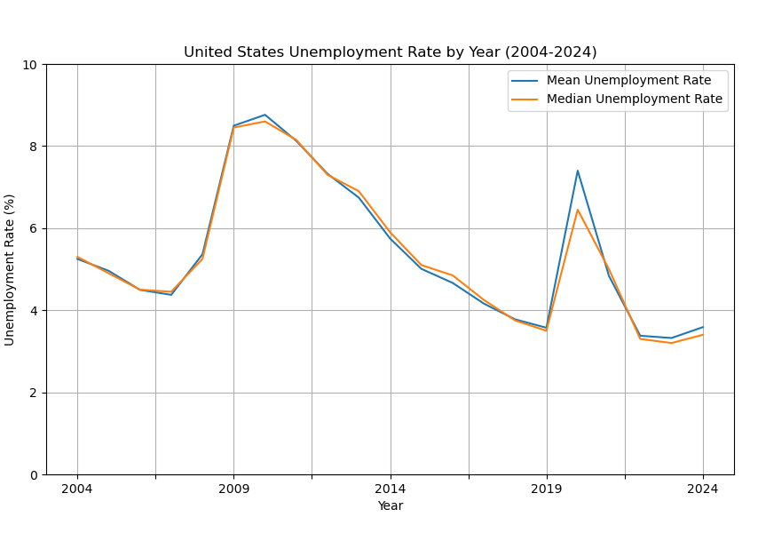
Unemployment Rates
The average and the median unemployment rates per year
Unemployment started climbing after the 2008 crash
It peaks at around 2010
We see a steady decline for about 10 years, until 2020, when Covid-19 hit

Slide 13
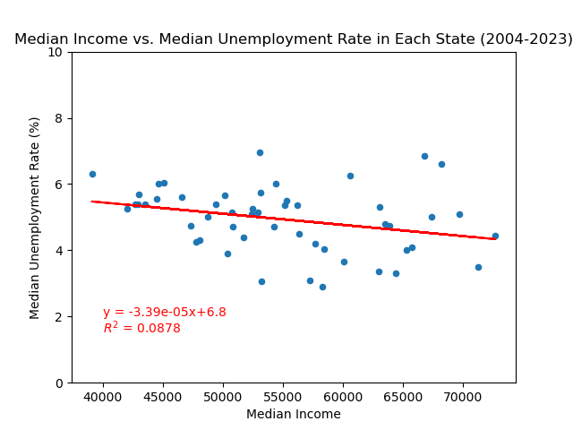
Median Unemployment Rate vs. Median Income
Relationship between median income and median unemployment rates
The value of R squared is less than 0.5
There is almost no correlation between the median unemployment rates and median incomes

Slide 14
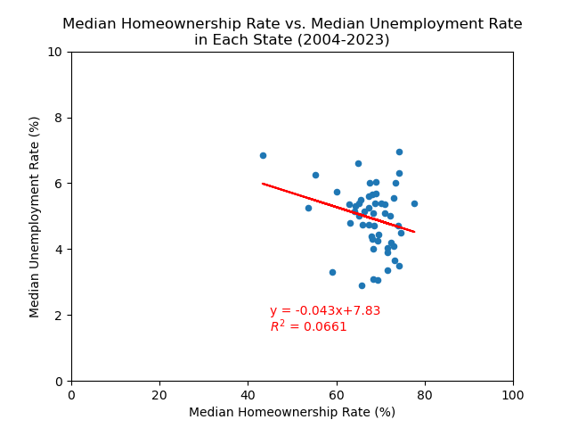
Median Unemployment Rates vs. Median Homeownership Rates
Comparison between unemployment rates and Homeownership rates
After calculating the correlation, the R squared value is less than 0.5, meaning that there is little to no correlation

Slide 15
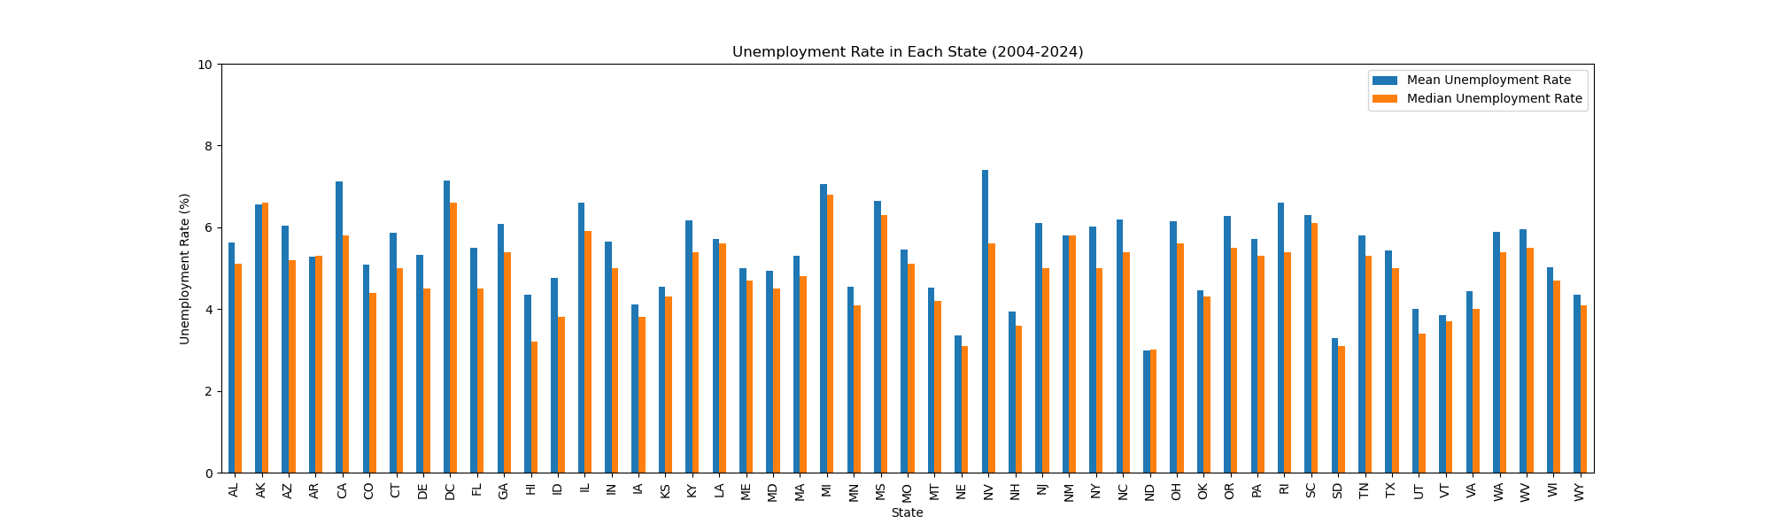
Mean Unemployment Rate vs. Median Unemployment Rate
Mean per state tends to be larger than median measurements.

Slide 16
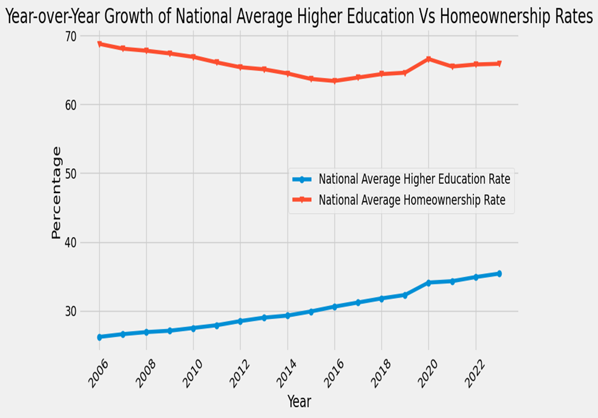
Analysis of Trend Over Time
Peaks:
Home ownership: peaks at around 2006
Higher education: peaks at around 2020
Trough:
Home ownership: was at it’s lowest around 2016
Higher education: No significant decline was observed
Overall Observations:
Higher Education shows consistent growth over time
Homeownership has faced steady decline
No correlation between seen

Slide 17
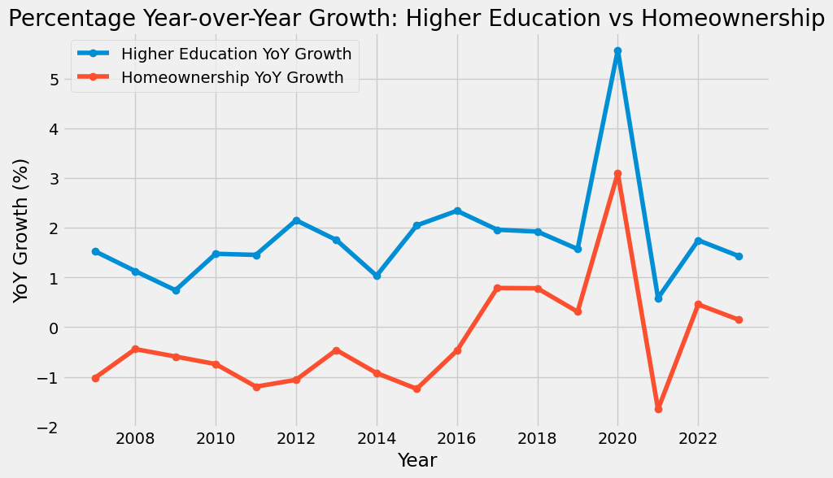
Analysis of Percentage Year Over Year Change
Periods of Growth And Decline: Significant percentage growth was seen in 2020 Significant percentage decline occurred in 2021

Slide 18
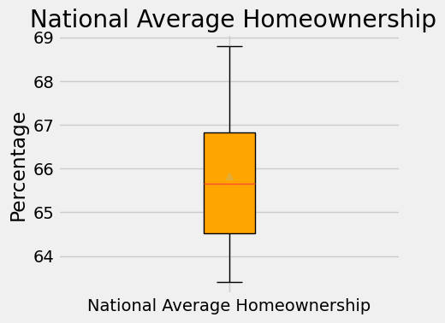
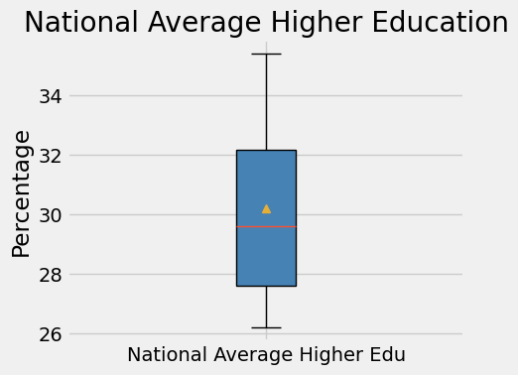
Homeownership vs. Higher Education
Data Distribution
Key Observations:
No outliers are present in either dataset as all data points fall within the bounds.
US Avg. Higher Edu shows a slightly broader spread, with mild skewness toward higher values.
US Homeownership is more symmetrical and consistent across the data points.

Slide 19
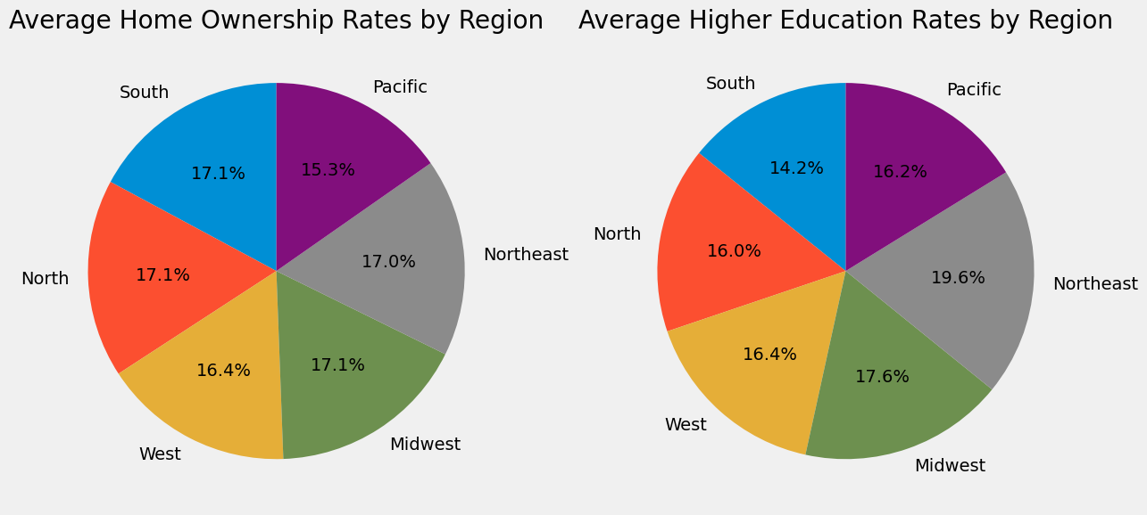
Percentage of Home Ownership
&
Higher Education Rates by Region
States in the Northeast and Midwest regions generally show higher education rates
The Southern regions tend to have lower average higher education rates
South, North and Midwest regions typically having higher home ownership rates compared to the West and Pacific
The South shows higher home ownership rates but lower higher education rates.

Slide 20
References:
https://fred.stlouisfed.org/
FRED API
https://www.fedprimerate.com/wall_street_journal_prime_rate_history.htm
https://www.hudexchange.info/resource/3031/pit-and-hic-data-since-2007/

